Slide 1

General Project 2
By: Ameera Syed

Slide 2

Microsoft
Microsoft values culture and diversity, as a result, their writing will also be culture-sensitive.
Microsoft values hybrid work, therefore, communication and writing will be split between online meetings and presentations and then formal reports and constant emails and conversations with peers.
Workers need the ability to convey complex ideas to diverse audiences
Writing must be clear and concise. It should reach technical and nontechnical audiences.

Slide 3
Working industry
In the working industry, workers need to convey their ideas clearly and in presentations.
Communication skills are key in this, along with time management and precision.
Microsoft works with people of varying skills, customers and workers have highly different skill levels, resulting in workers needing to be active listeners to address issues of various audiences.
In-depth documentation regarding production should be tended to on the technical side, which may require higher-level language and terms.

Slide 4
Non-Technical
Microsoft also works with many people who know very little about computers.
Writing may include instructions, troubleshooting, emails regarding support, and many other forms.
Workers must be active listeners in order to properly address the issues customers are experiencing.
Instructions must be concise and clear, in order to best help users, this also includes remaining accurate.

Slide 5

AI and the Future of Work
By: Ameera Syed

Slide 6
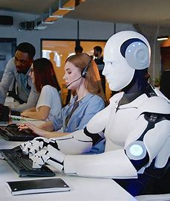
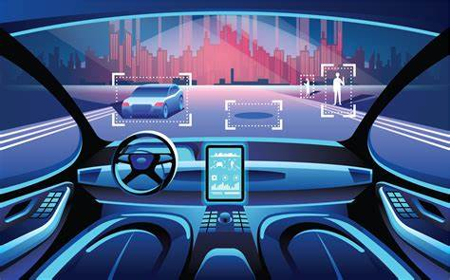
What is AI
ChatGPT
Robots
Self-driving cars
Automation
Intelligent systems and machines
Machine learning
Deep learning
Algorithms
Data sets
Notes:
Artificial intelligence, for the sake of this presentation, I will refer to AI as the notable systems, such as ChatGPT, and also automation, such as robots, self-driving cars, and more.
AI focuses on human intelligence, replicating it and analyzing it
There are different types, narrow, general, and superintelligent, focused on different levels of intelligence
As technology advances, AI has also improved, causing society to change and alter.
Systems and machines that are able to perform tasks are included in this section
This includes the ability to learn, understand, recognize problems, solve problems, and make decisions.
As a result of this, AI use in the job industry has become relatively popular
AI itself is the development of systems, encompassing machine learning, deep learning, algorithms, data sets, and much more

Slide 7
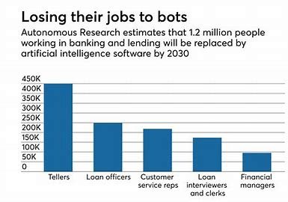
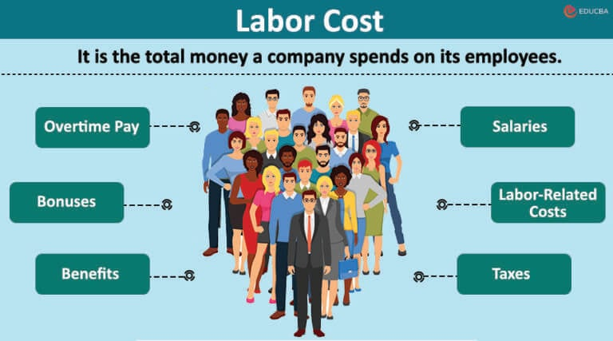
Displacement
Benefits of AI
Efficient
Cost-efficient
Long-term productivity
Demand for automation increases
Constantly improving
Consequences
Gap between society
Economic imbalance
Displacement of workers
Decreased demand for workers
Societal plateau
Chain result of businesses closing down
Example: Macy’s
Notes:
AI is cheaper in the long run, creating a financial imbalance between workers
By looking at the graphic, we can see a few examples of financial sectors that would save money for business owners when considering AI over workers
Labor costs are relatively lower for AI compared to employees.
AI is also more effective and doesn’t grow tired when working
Demand for workers will decrease while demand for automation increases
Millions have been displaced
Greater gap between society and economic imbalance created
This also causes businesses to slow from a chain result
As people are displaced, products will remain on shelves and aren’t purchaseable, forcing businesses to shut down.
This is already noticeable with companies like Macy’s shutting down and several malls nearing bankruptcy
As a result, economic imbalance will force a shift in society, causing unemployment to increase and creating a larger economic gap between social groups
In the end, this will cause a societal standpoint or plateau, making society unable to progress further

Slide 8
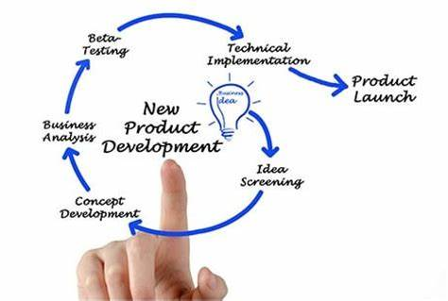
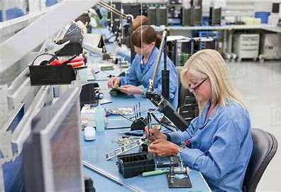
Creation
New inspiration
Innovation of the products
Self-owned businesses
Skill shift
System analyst
Data analyst
Machine learning specialist
Notes:
Although AI is taking over many jobs, it’s also able to provide new ideas and also motivate people towards newer jobs
Technology 10 years ago compared to today are vastly different from envisioned
Many new jobs were created as technology advanced and is expected to continue to
The growth in technology brings creative people to the workforce, people who once envisioned flying cars and other products
Like in the past, robots were once thought unimaginable, but were eventually pursued and created
Inspiration
Innovation
Development of new products
This will lead to newer self owned businesses which also require human input to best navigate sales and departments
Motivation increases and this leads to newer products which require web designers
Fresher ideas will lead to more jobs, and although some jobs will be replaced, newer jobs requiring newer skills will emerge
Therefore, jobs won’t decrease, but rather will shift, causing a shift in demand for skills
System and data analysts, machine learning specialists, and maintenance roles will also emerge in the AI industry
Maintenance jobs will also emerge, specifically in medical
Summary: AI creates new jobs but changes skill sets requires

Slide 9
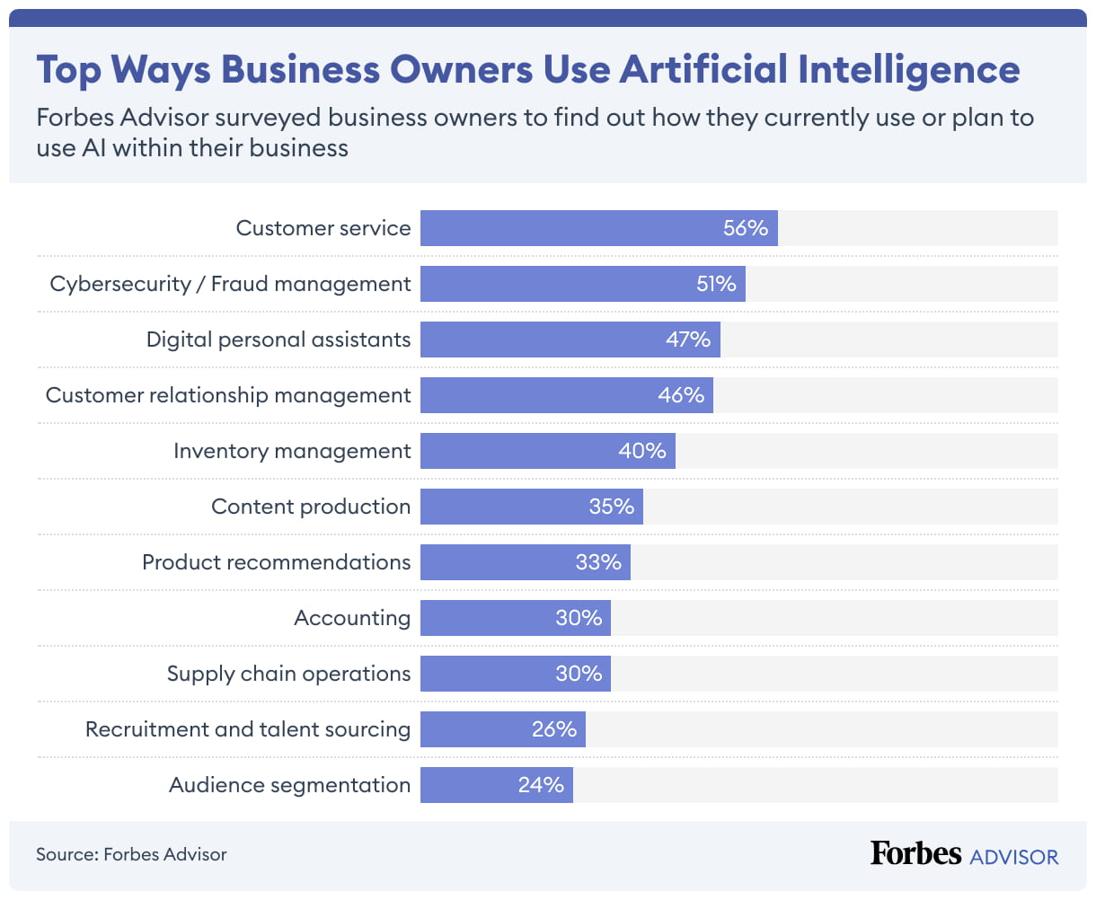
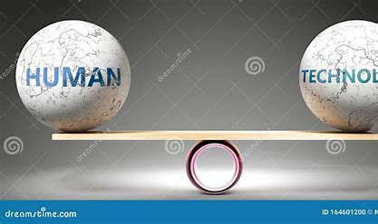
Business’s Role
Responsible for
Wages
Number of employees
Prices
Programs
Implementing AI
Keeps the balance in society maintained
Should promote higher employment rates
Focuses heavily on profit
Should invest in programs
Constant flow of money
Notes:
Through my research in my paper, I noticed that the impacts of creation and displacement in terms of jobs is causes by those in charge.
Businesses are responsible for creating a constant flow of money
This is by having a proper amount of workers and having reasonable prices
With the current state of businesses, displacement is seen to increase as prices rise with inflation, while the annual income and employment rates decrease.
Businesses are responsible for utilizing AI and implementing them, having them replace jobs
Companies should be motivated to implement AI in ways to increase productivity of workers while also maintaining a high employment rate to create societal balance, creating more profit
Businesses should invest in programs to help workers develop skills and mitigate job displacement for newer fields

Slide 10
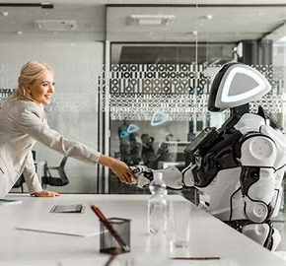
Interpretation
Notes:
To keep societal balance, AI needs to be implemented and utilized in ways to promote businesses and employment, this is by increasing the number of jobs, creating ways for people to enhance skills and investments in programs.
Motivation from the people towards newer jobs is required, along with cooperation from businesses to invest in these jobs to create a cycle of money flow, promoting job creation and productivity while also improving technology and quality of life.

